Slide 1
AceChallange Distance Estimation
Date: 20 Sept 2021

Slide 2
Roadmap
Research: 1 week (Nov 01-08)
Distance estimator + integration in backend + testing: 2 weeks (Nov 08-22)
Golf ball / hole detection: 2 weeks (Nov 15-31)
Testing / refining / updates: 2 weeks (Dec 01-14)

Slide 3
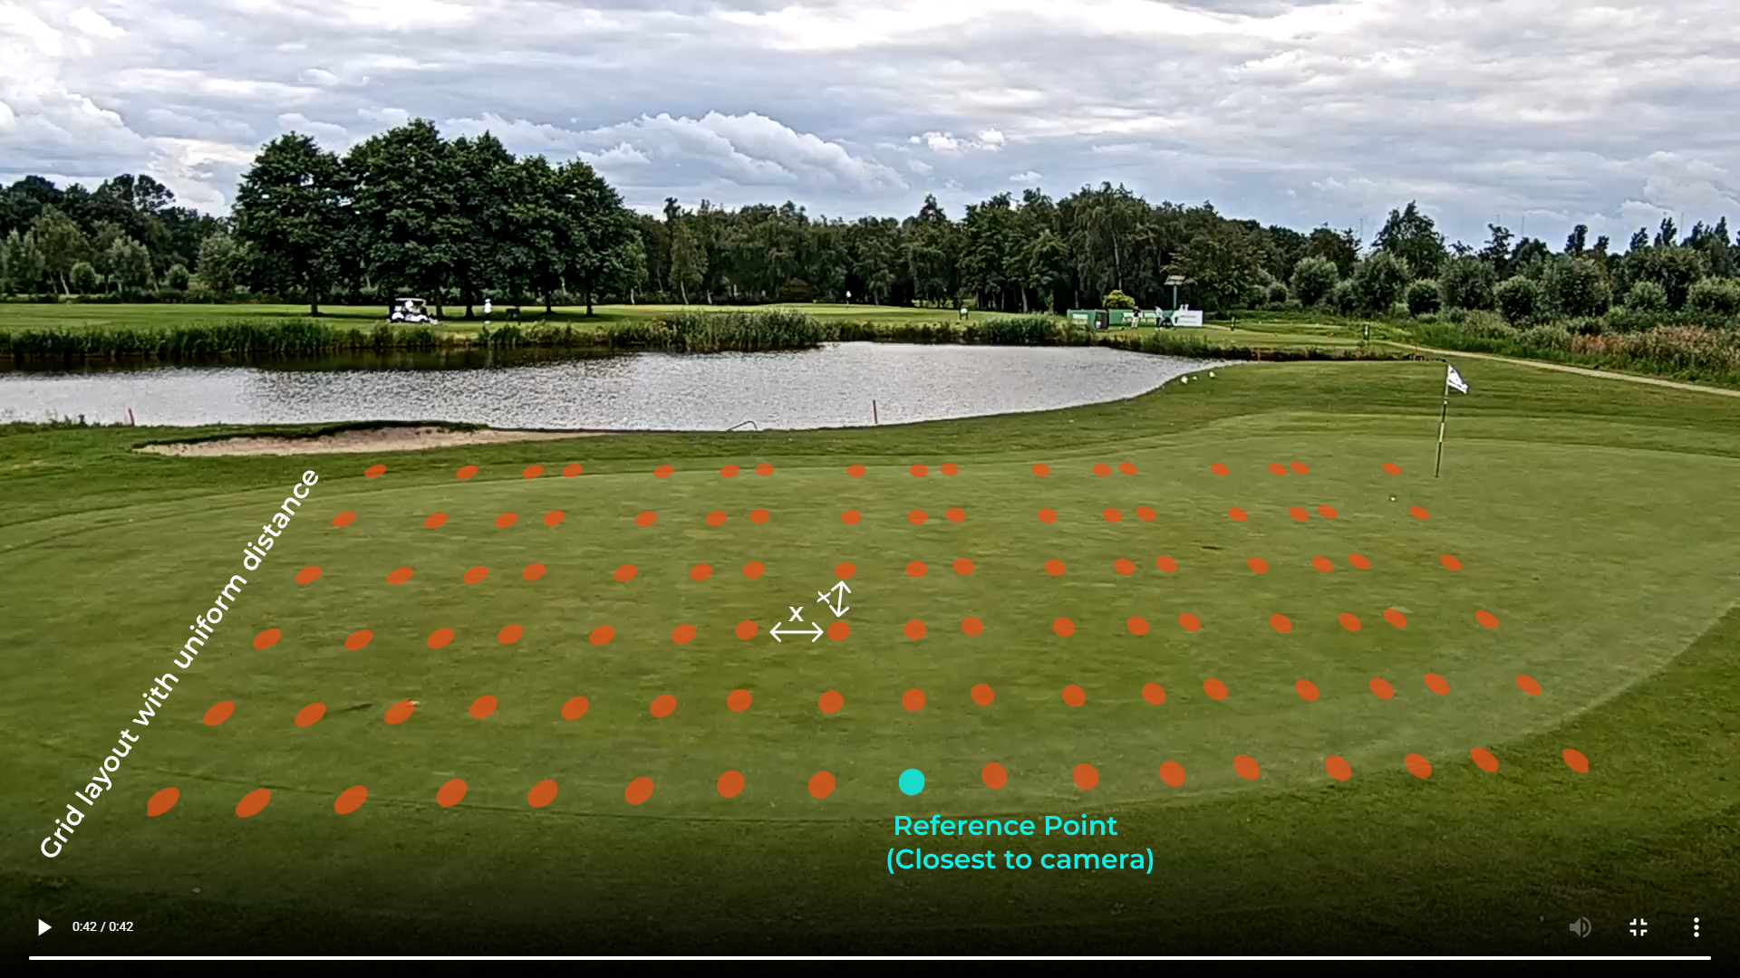
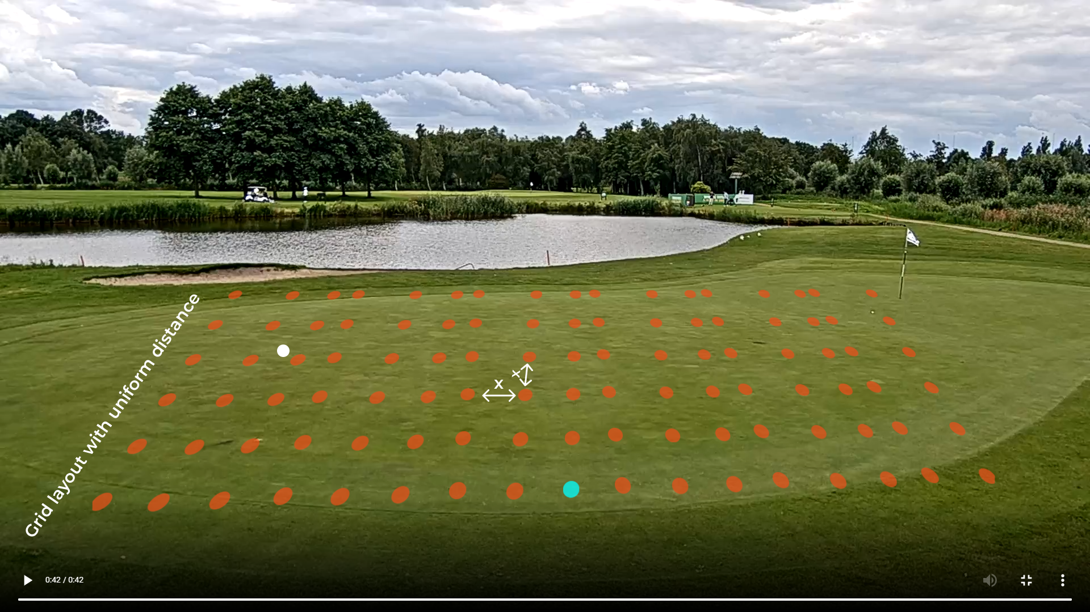
Grid layout
Record a pre-defined grid layout with uniform distance between the nodes on the golf field.
This is for calibrating the camera and making an association between the different points on the field and the image in pixels.

Slide 4
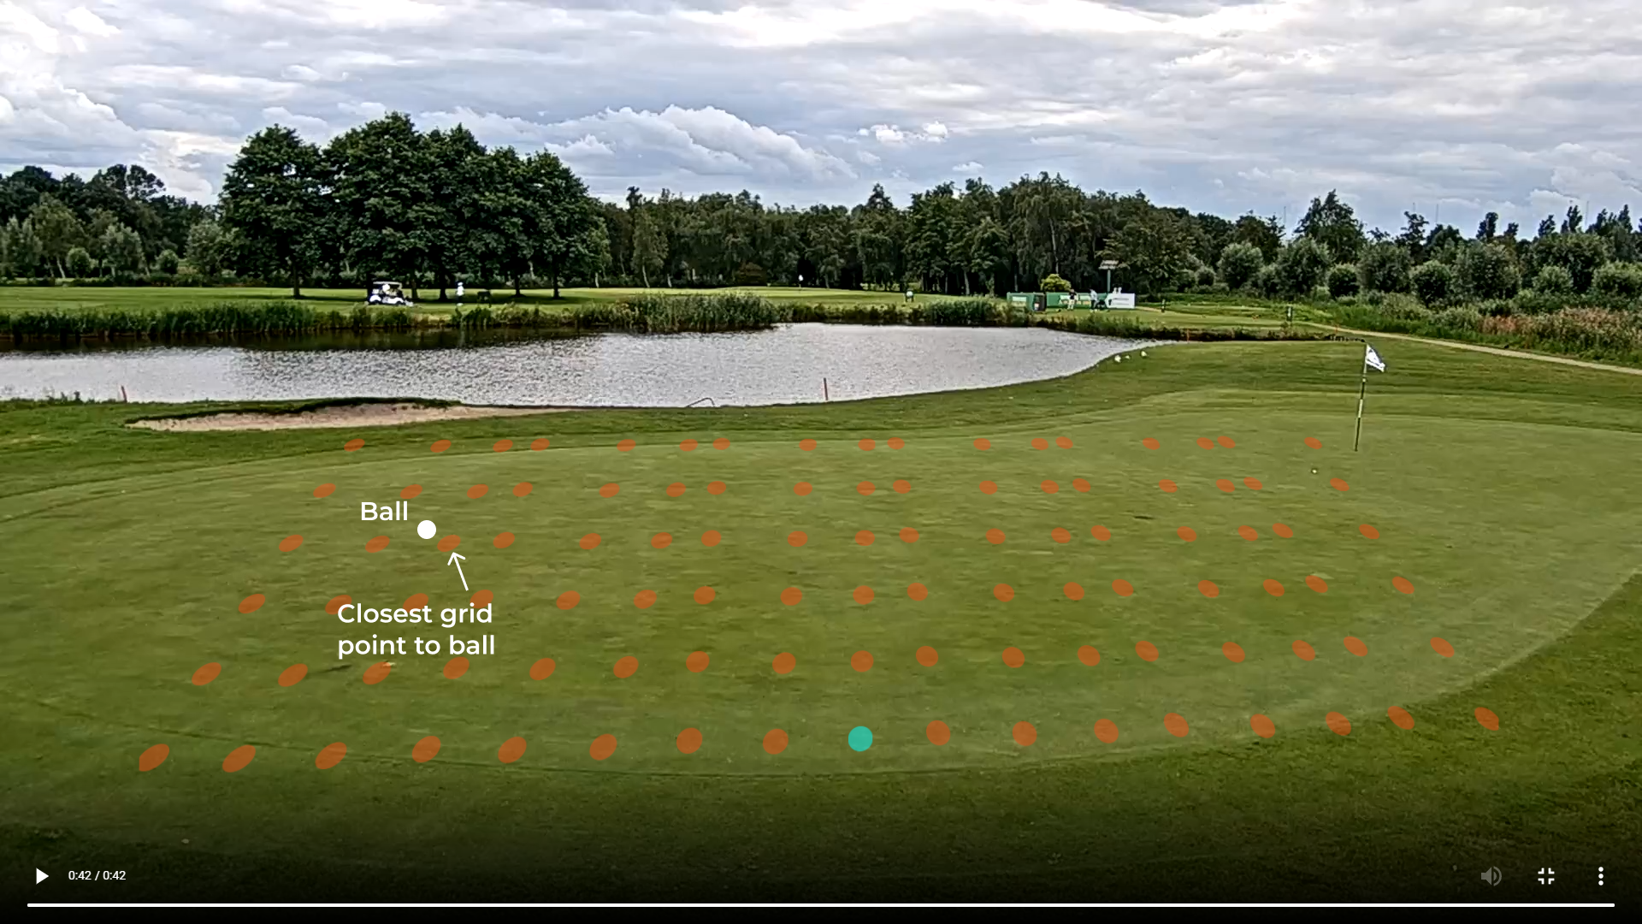
Distance estimation
After locating the golf ball on the field, we first find the closest grid point to it.

Slide 5

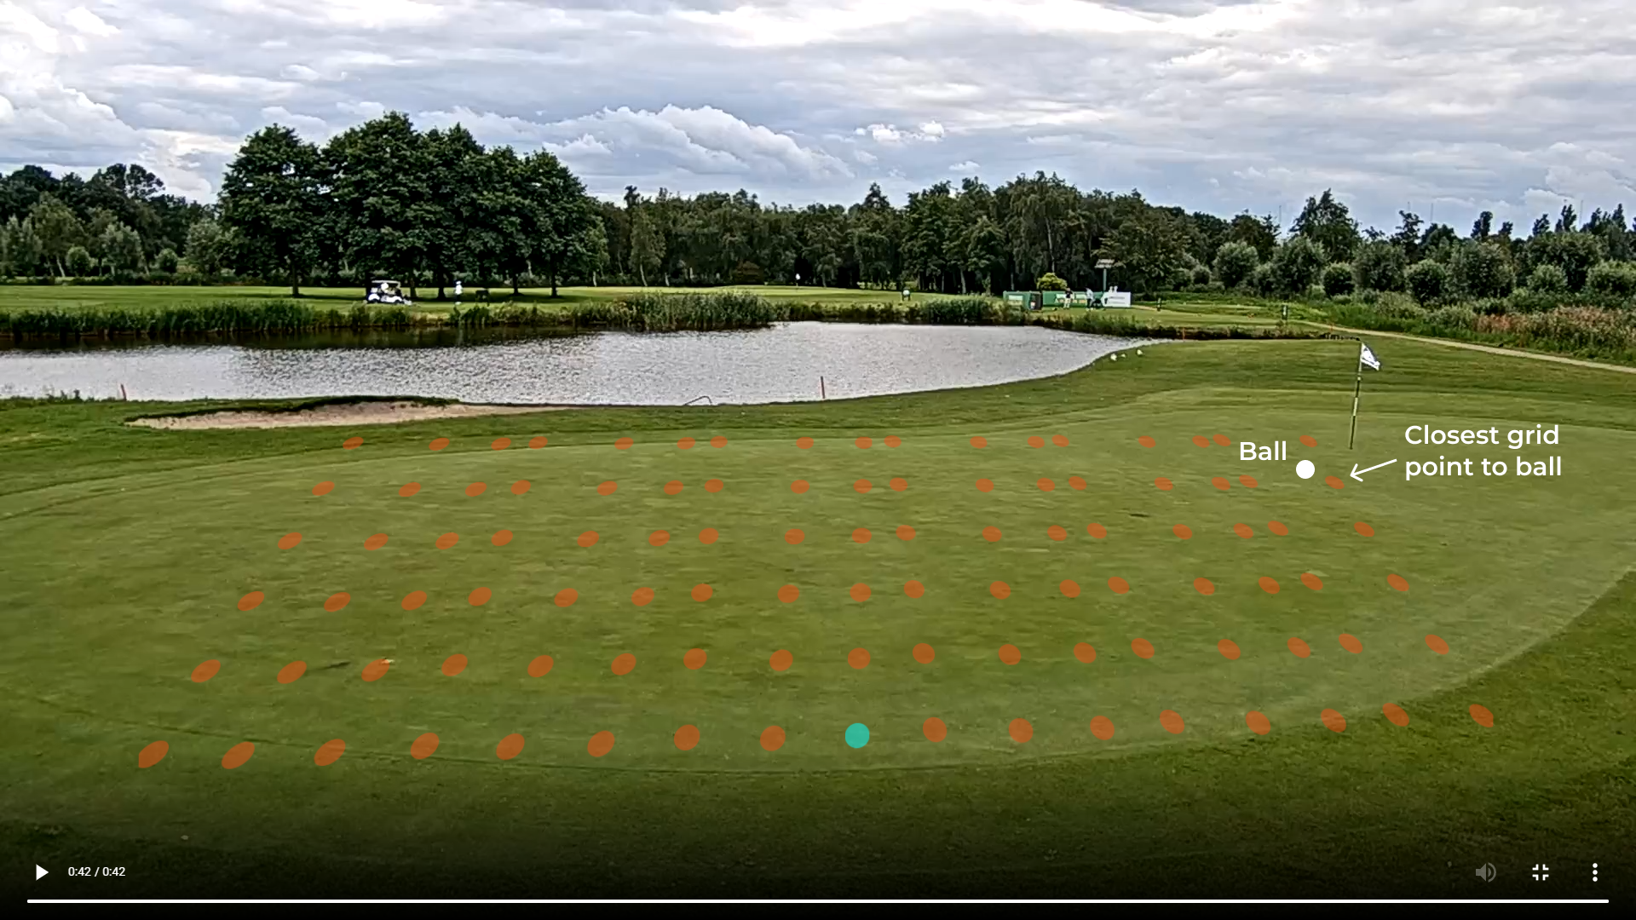

Distance estimation
Next we find the closest grid point to the hole.

Slide 6
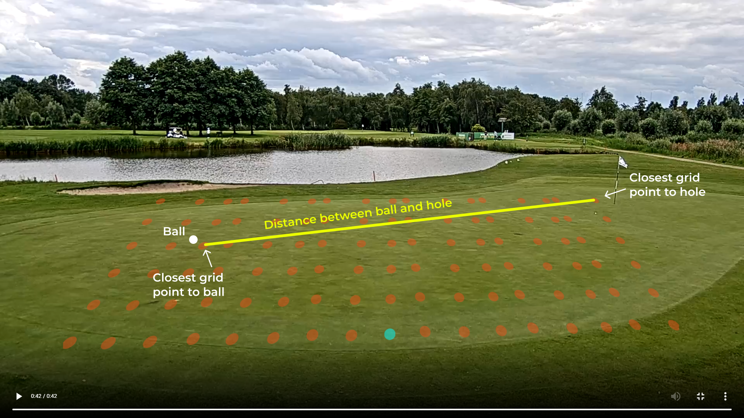
Distance estimation
We approximate the distance between the golf ball and the hole by calculating the distance between the two grid points (the one closest to the ball and the one closest the the hole).

Slide 7
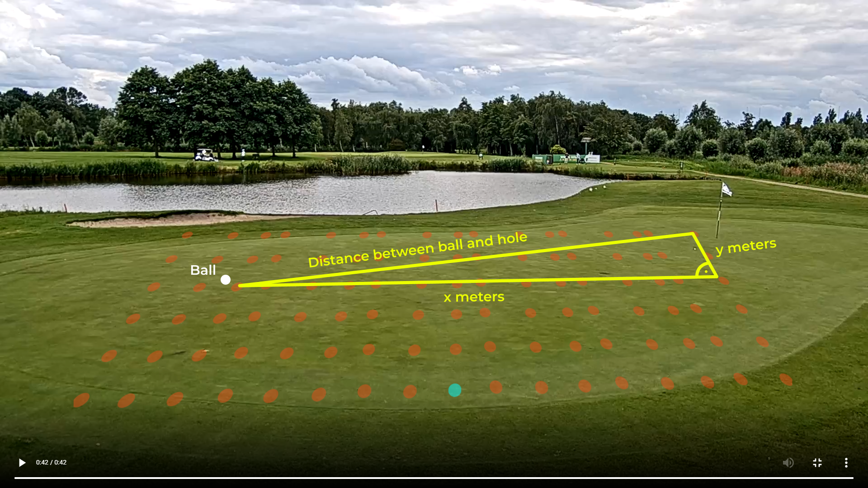
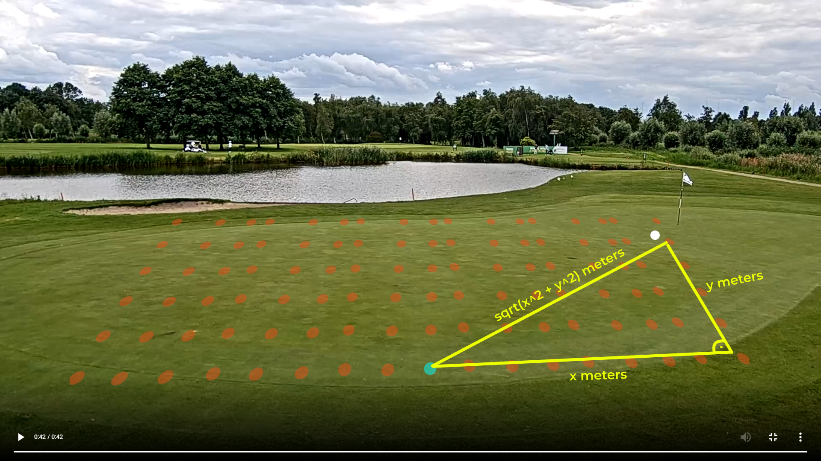
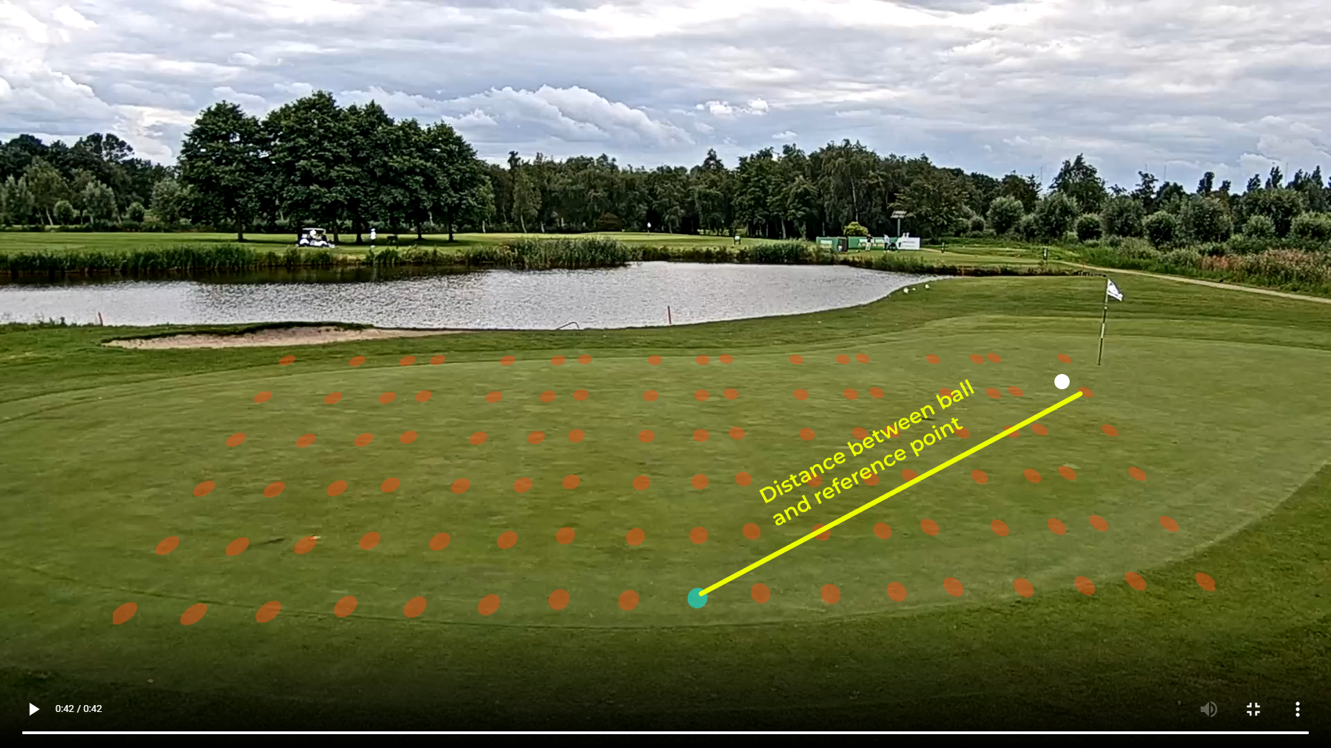
Distance estimation
To find the distance, we can use Pythagorean theorem. We can calculate the length x and y as our grid layout is uniform thus distance between each grid node is known.

Slide 8
Designed by SPINNOV

